Slide 1
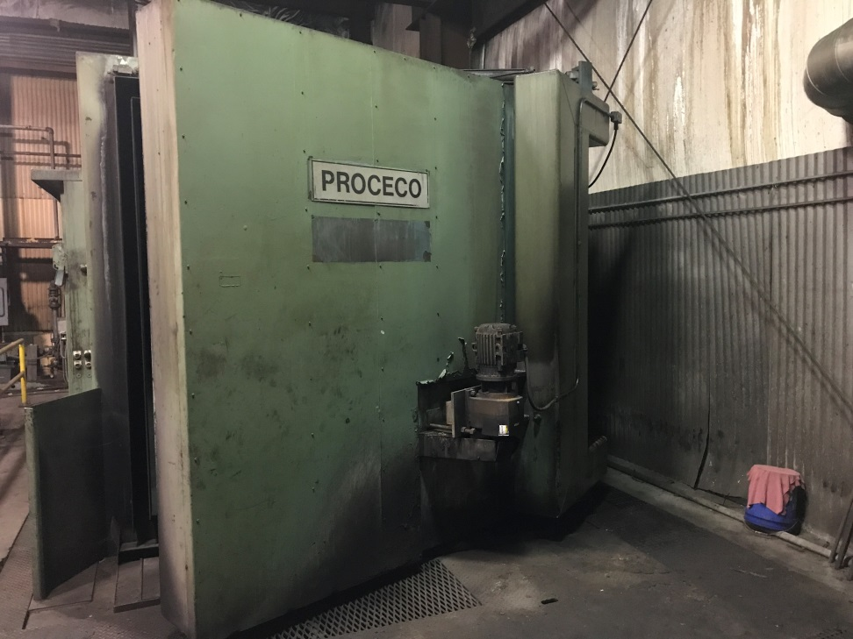
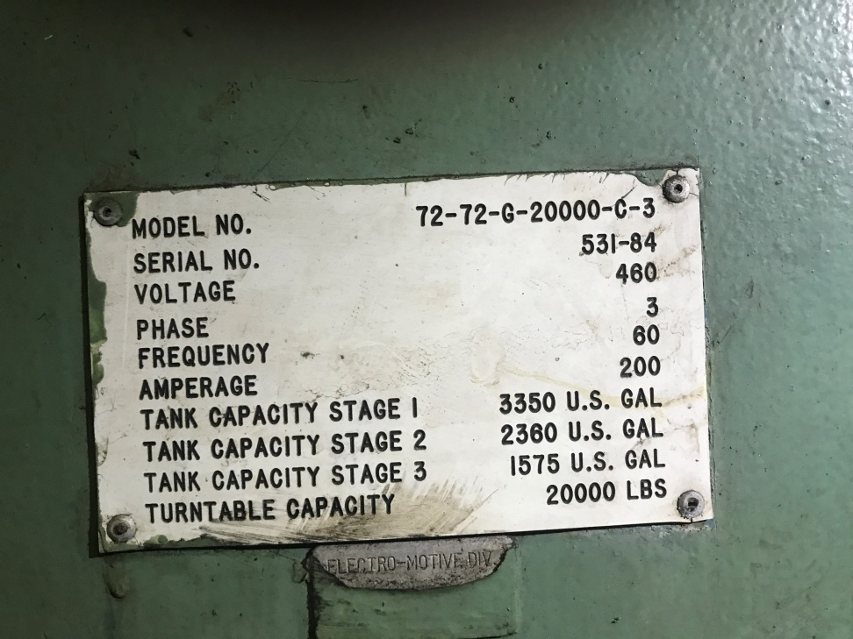
Proceco Washer Model 72-72-G20000-C-3

Slide 2
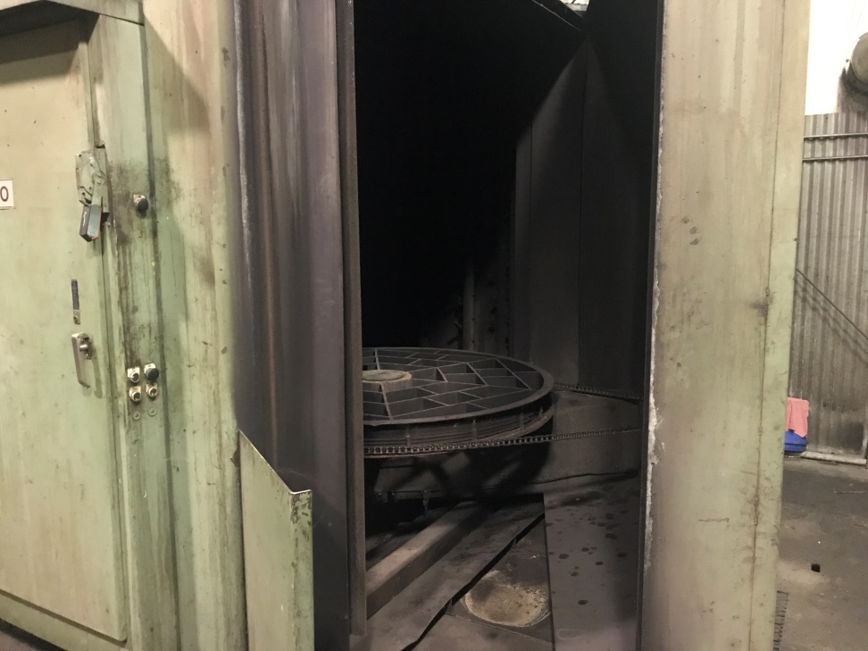
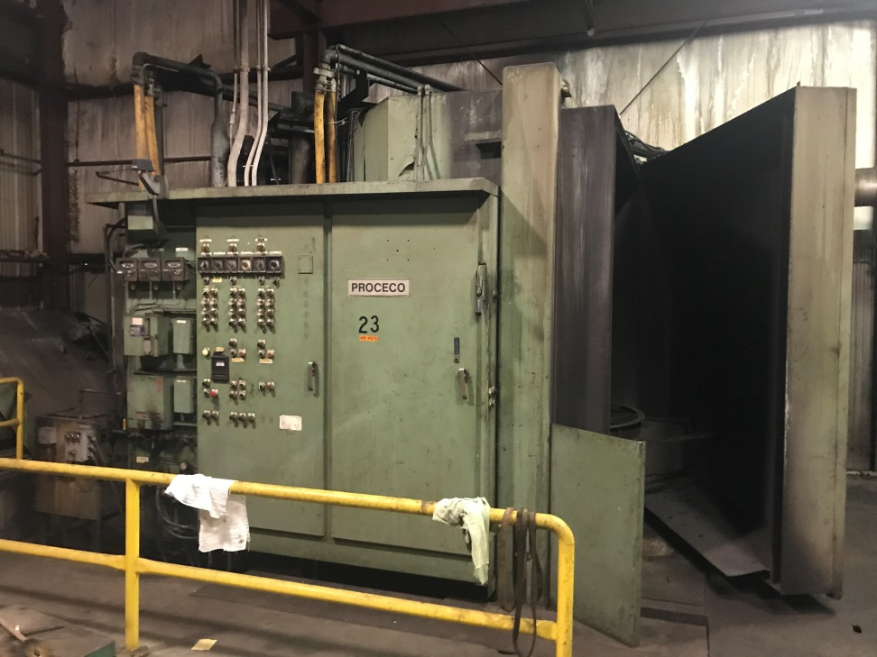
Proceco Washer Model 72-72-G20000-C-3

Slide 3
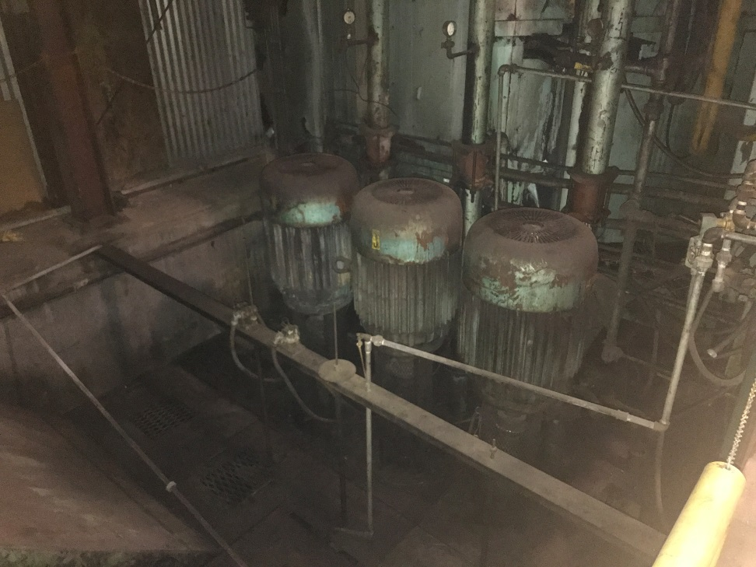
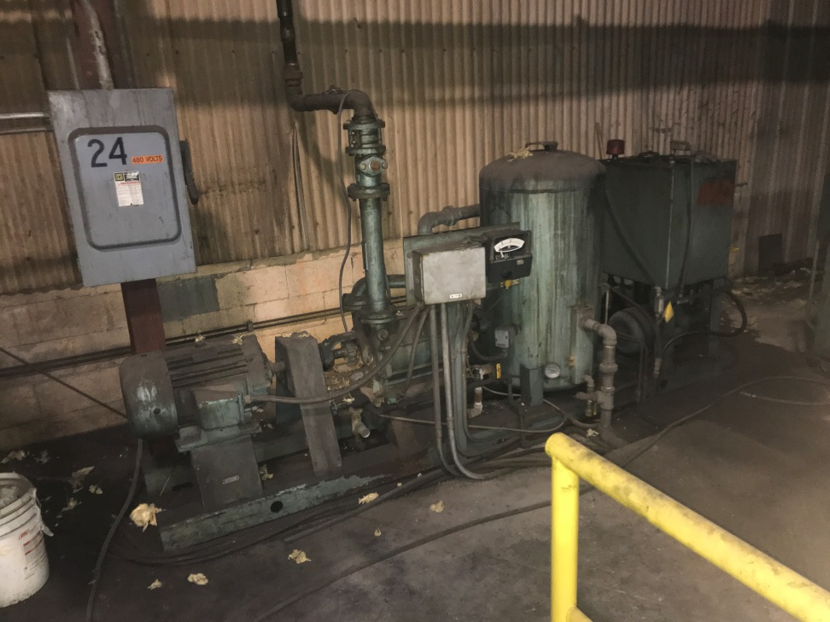
Proceco Washer Model 72-72-G20000-C-3

Slide 4
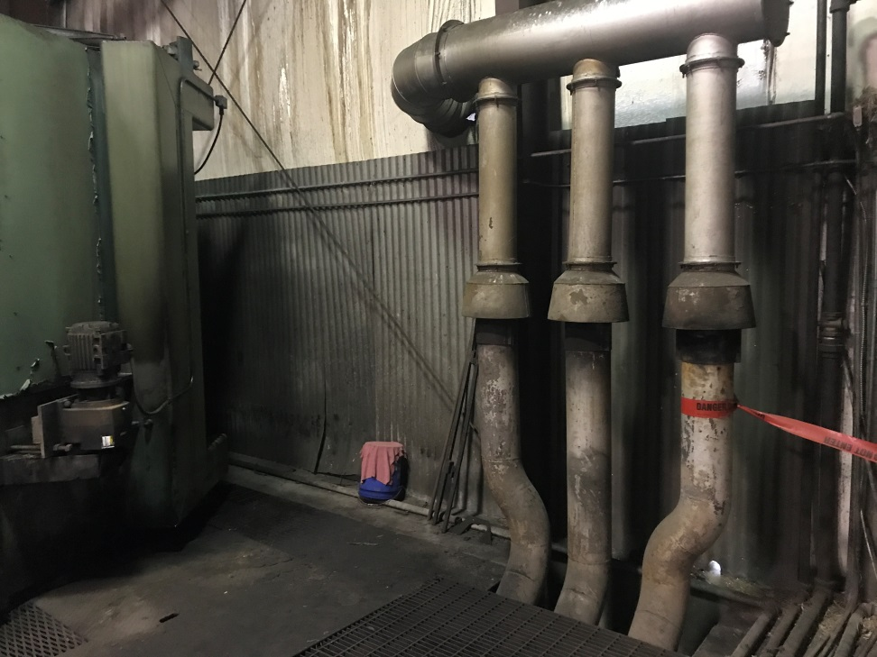
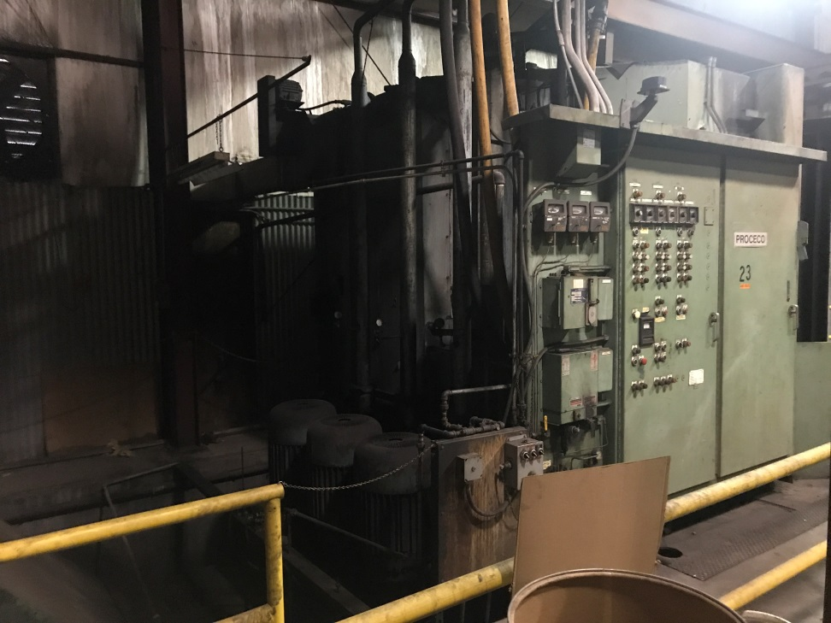
Proceco Washer Model 72-72-G20000-C-3

Slide 5
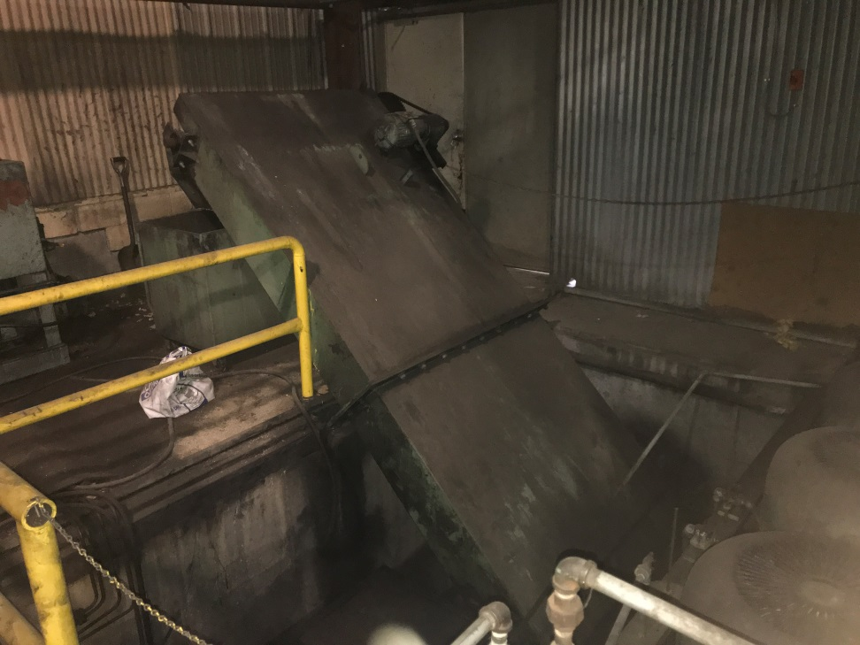
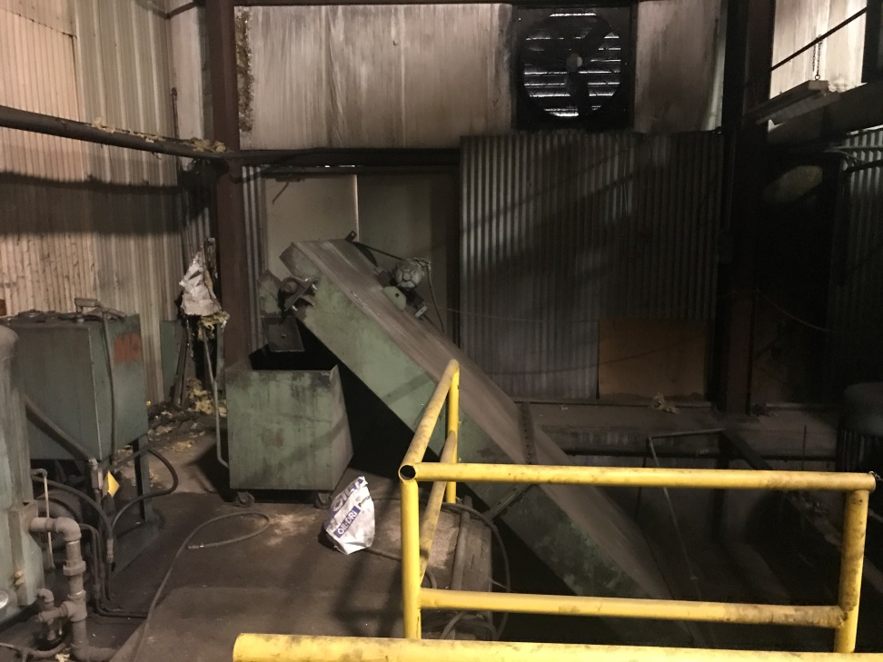
Proceco Washer Model 72-72-G20000-C-3

Slide 6
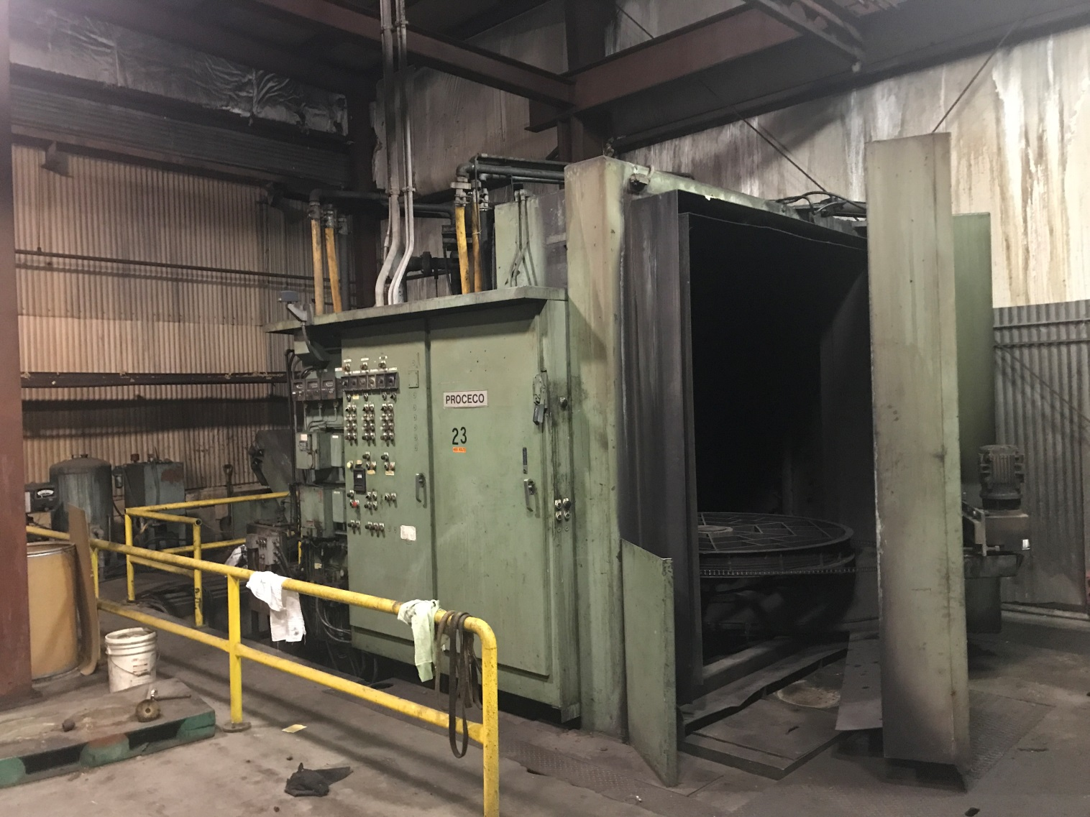
Proceco Washer Model 72-72-G20000-C-3

