Slide 1
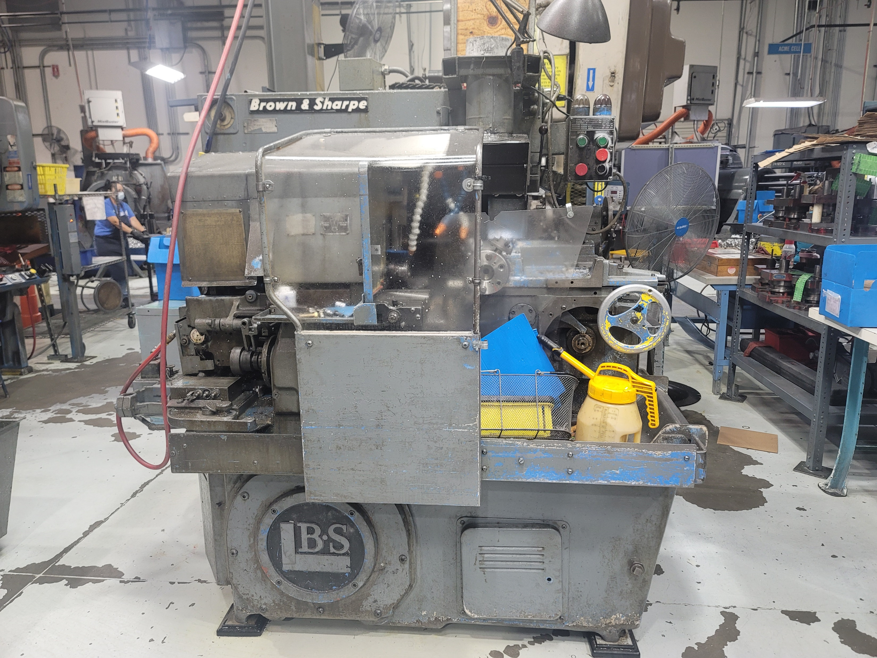
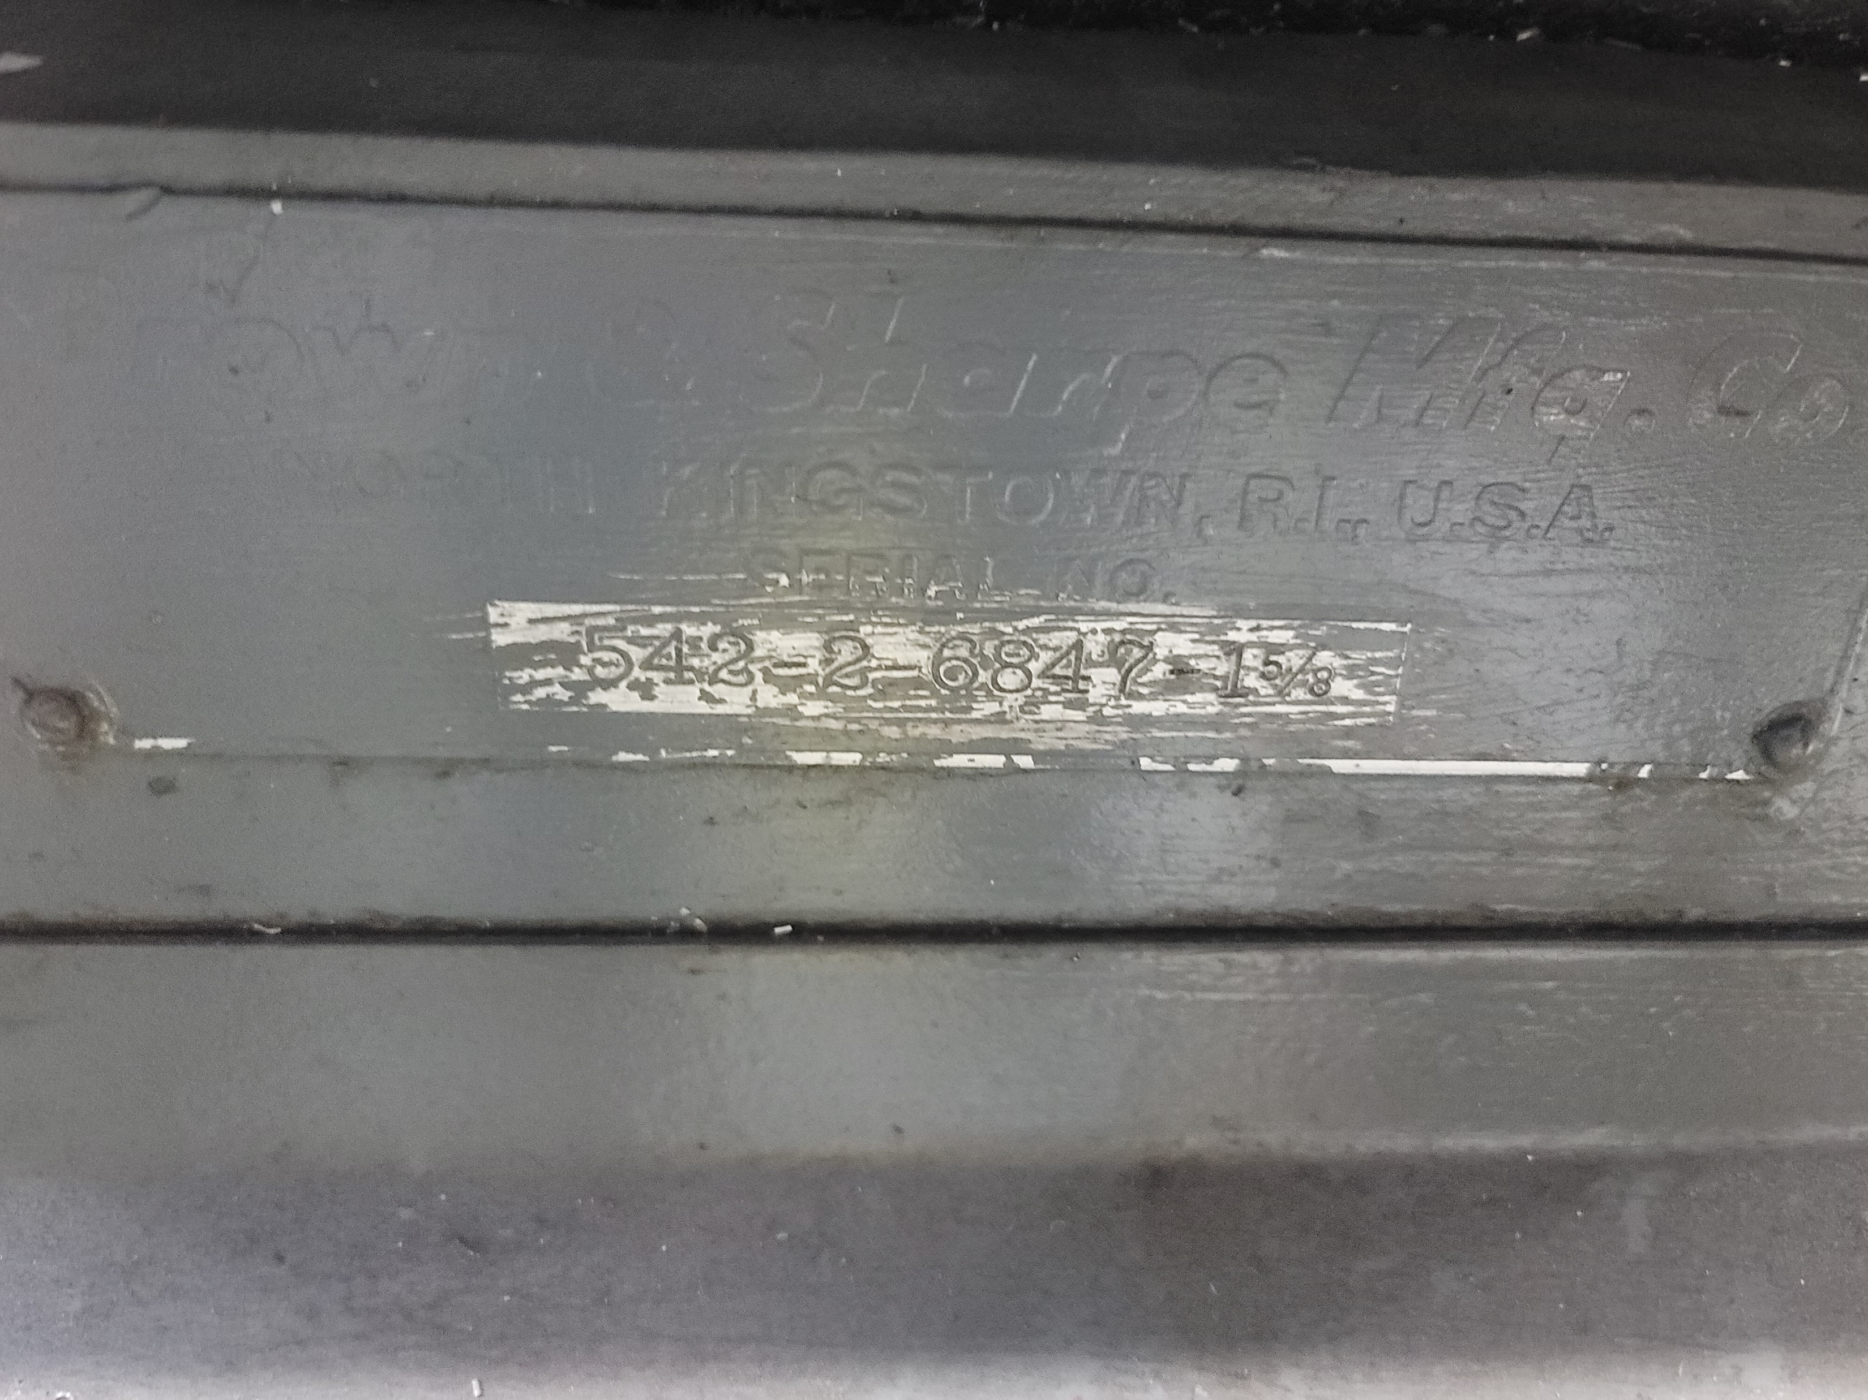
Brown & Sharpe Lathe 1 (1-5/8") BS-01
542-2-6847 87088

Slide 2
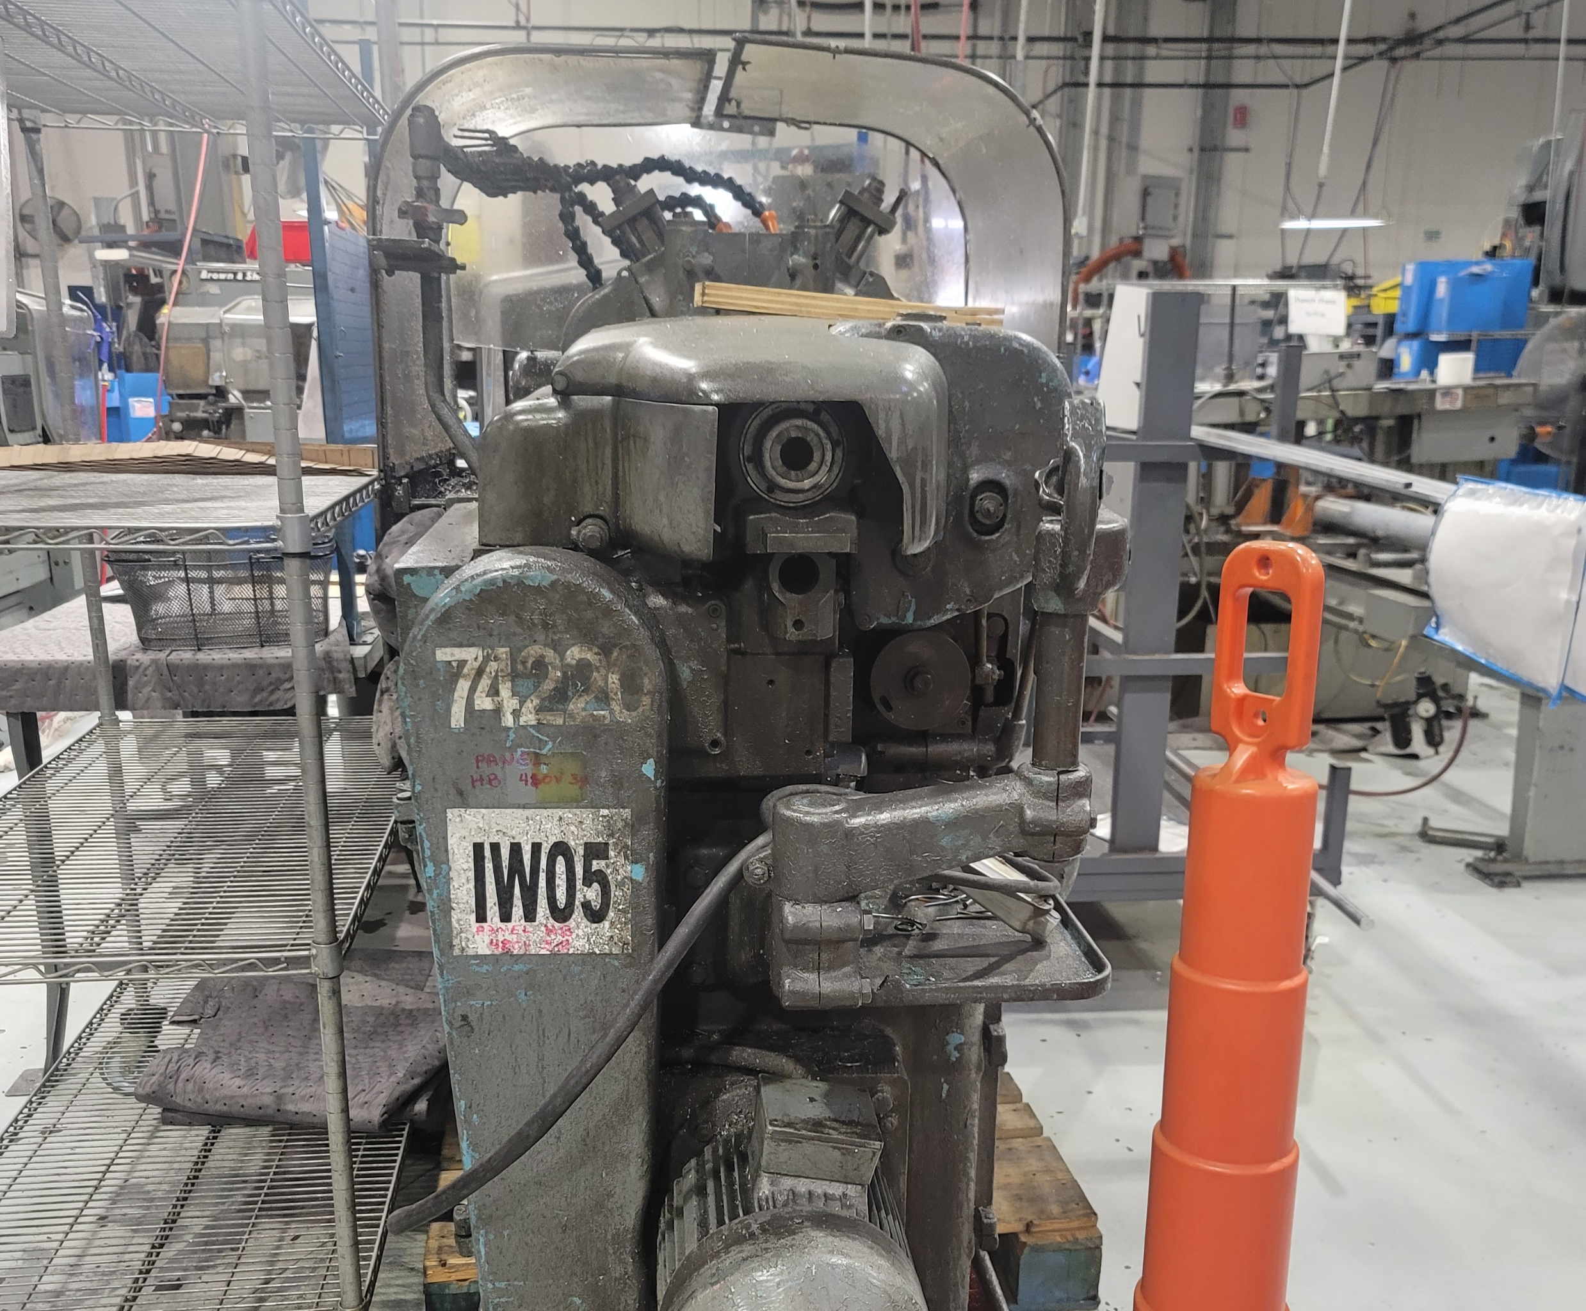
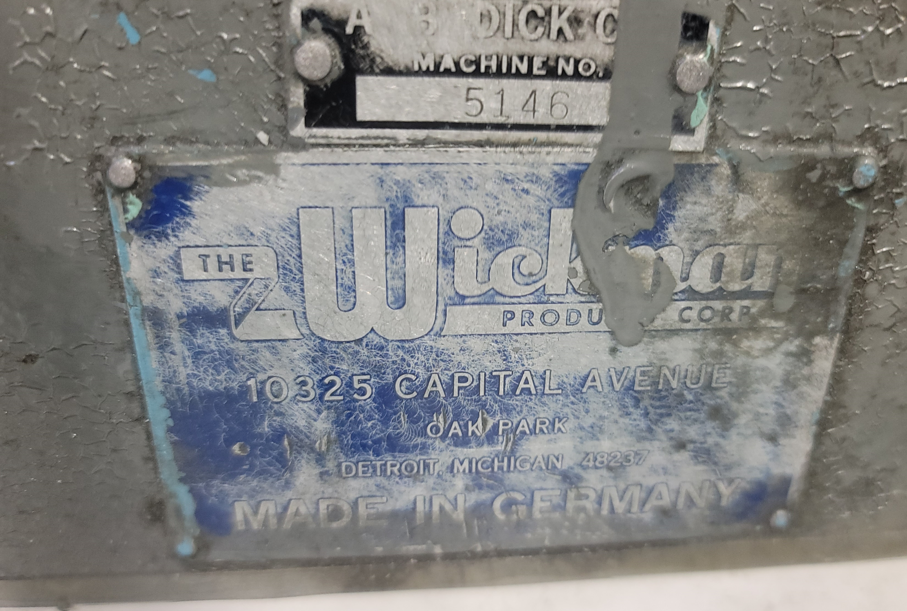
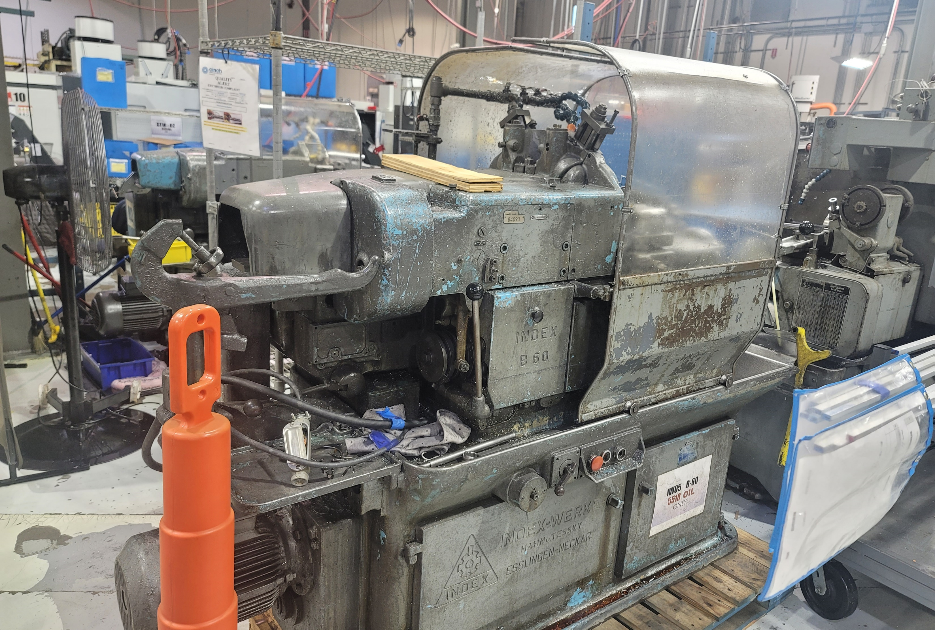
Index 5 B60 Lathe IW05 B4264188 84098

Slide 3
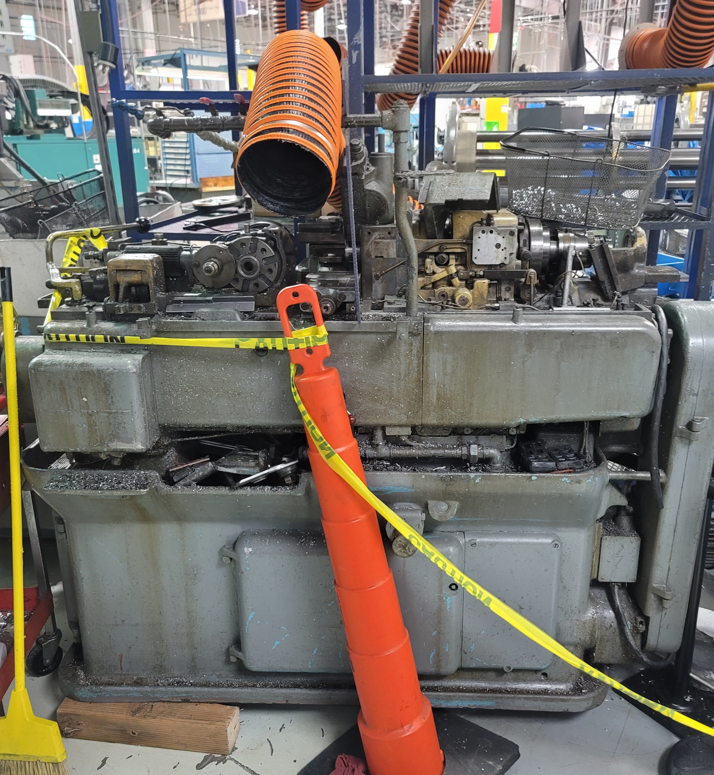
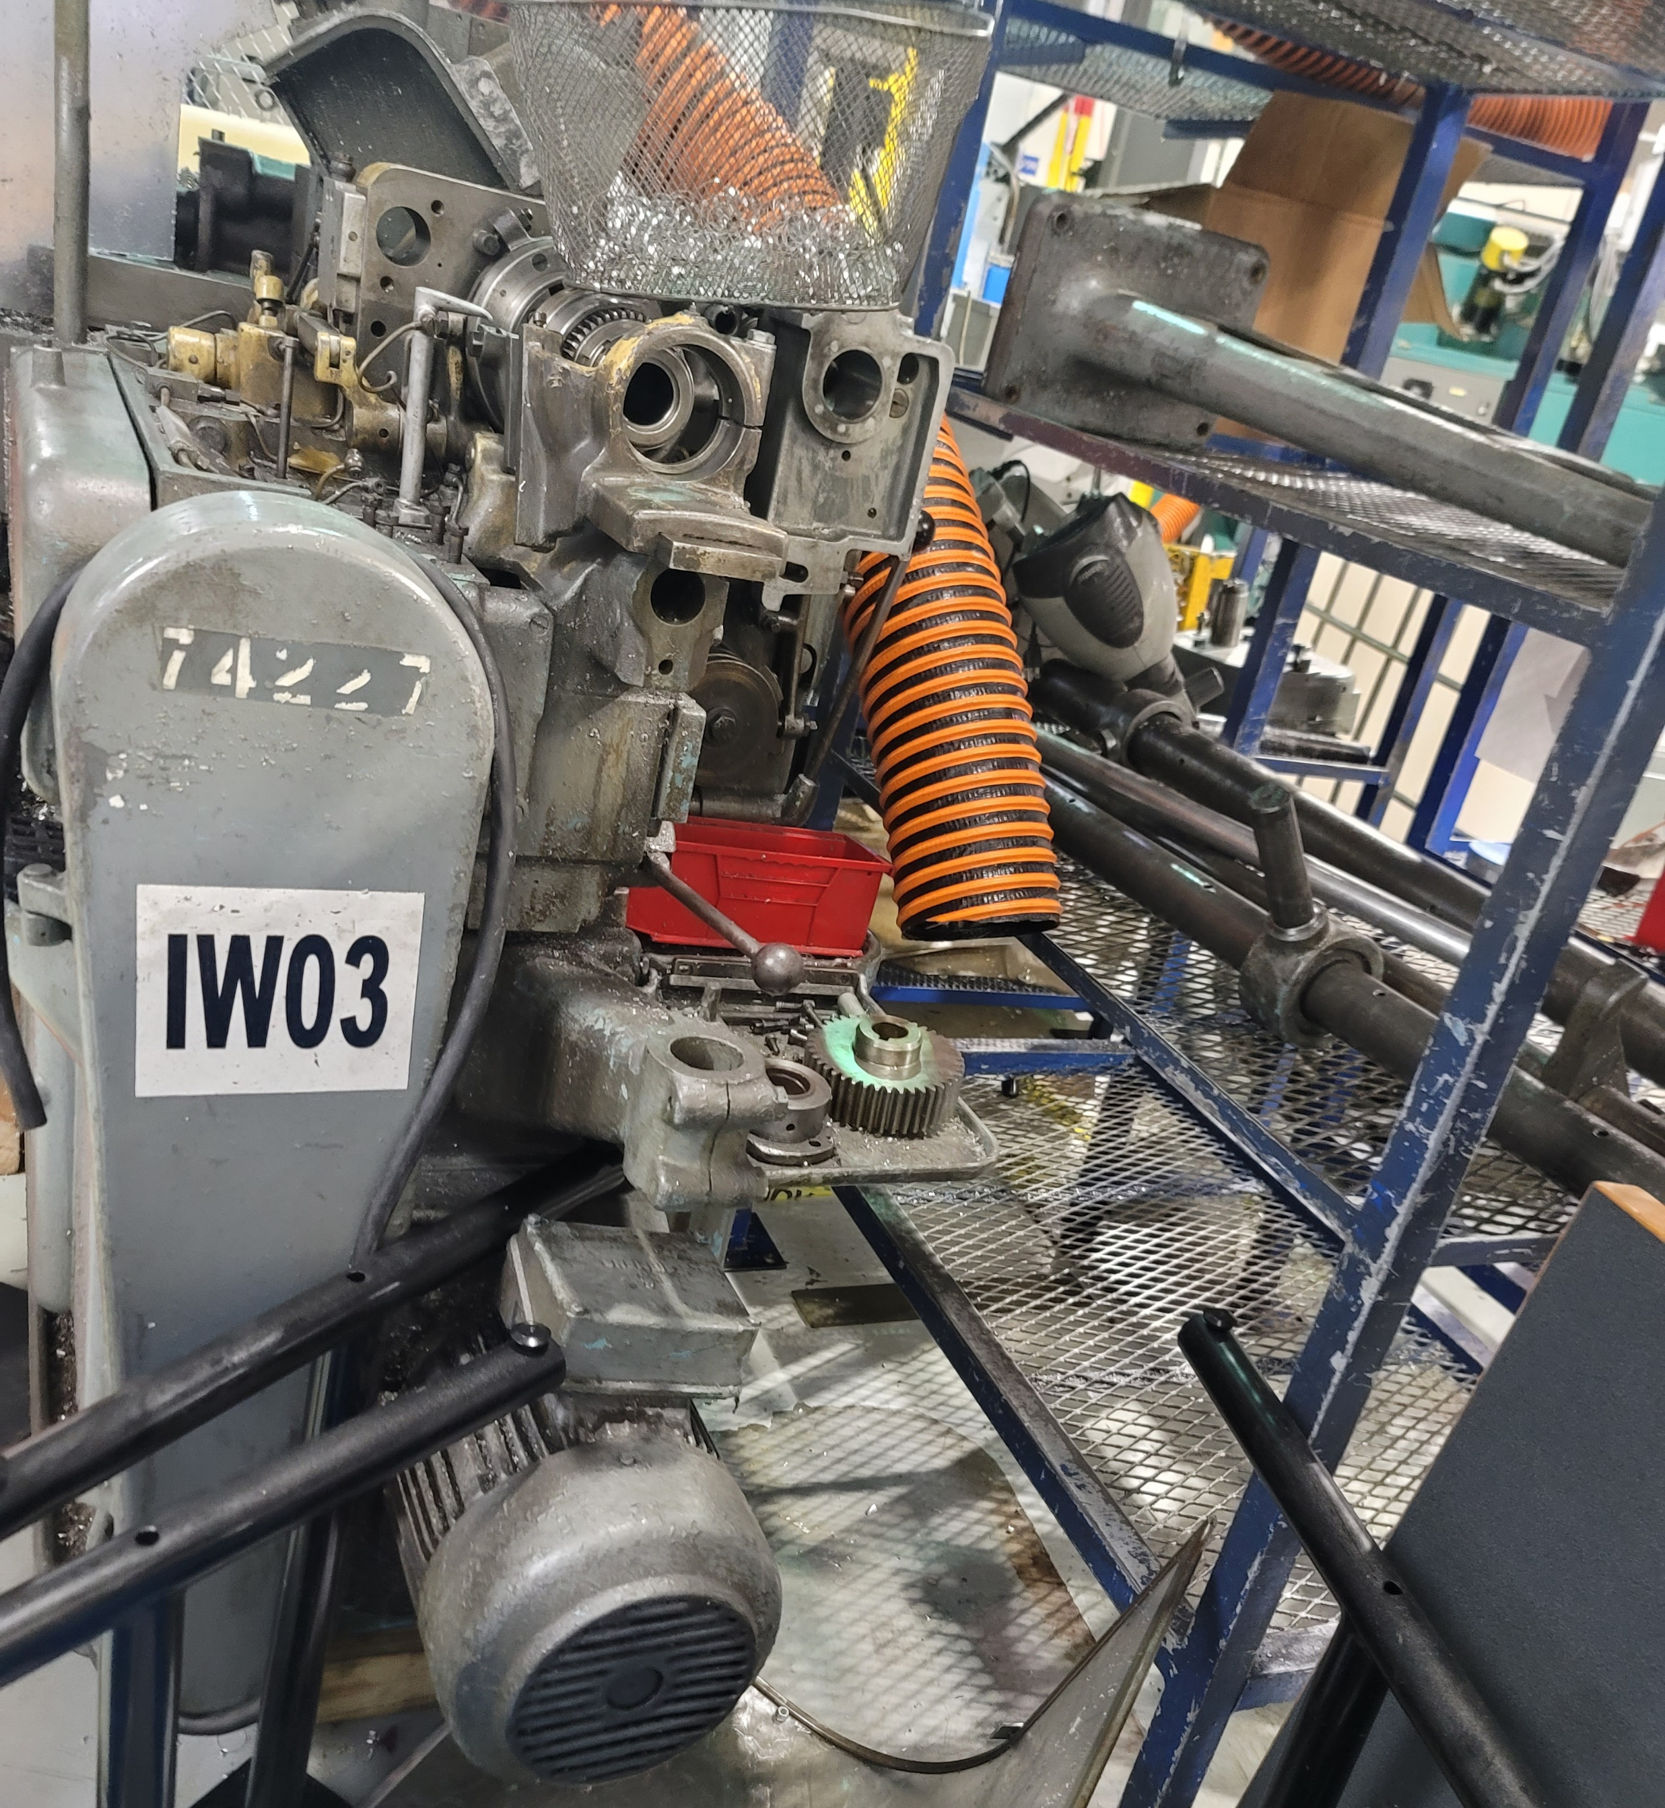
Index 3 B42 Lathe IW03 Need Serial Number

Slide 4
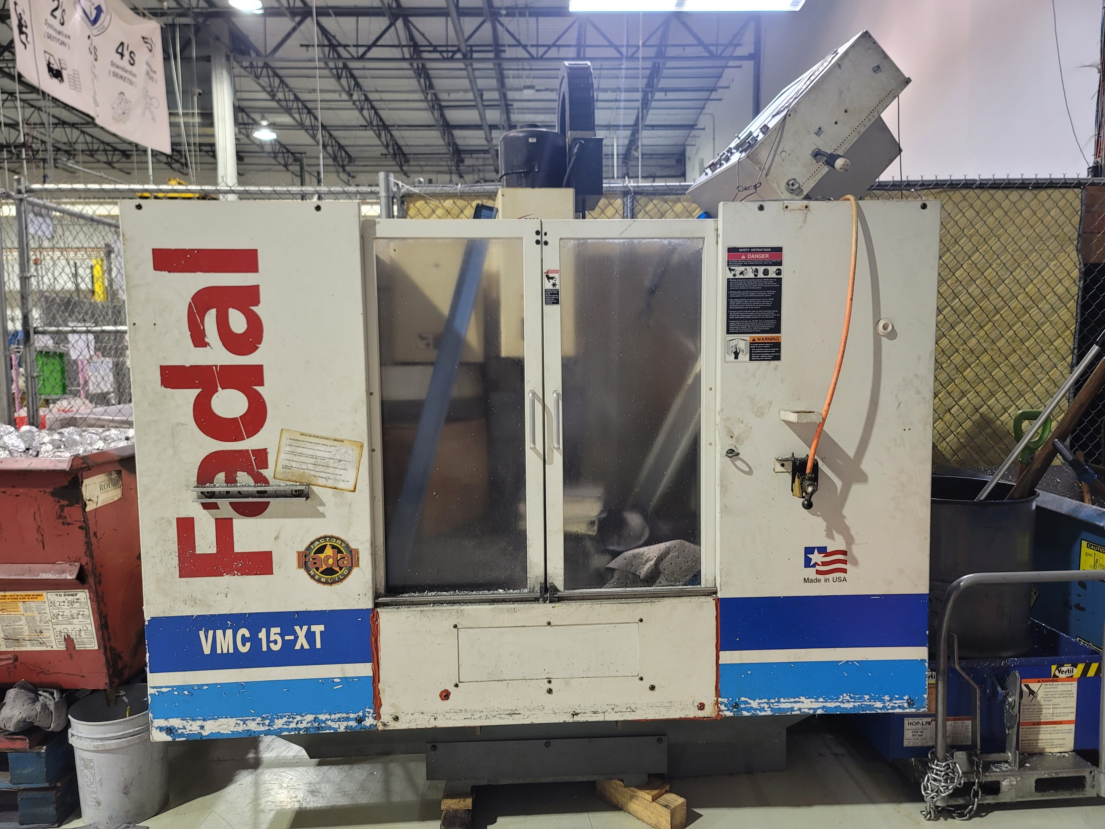
Fadal Mill – Need Serial Number

Slide 5
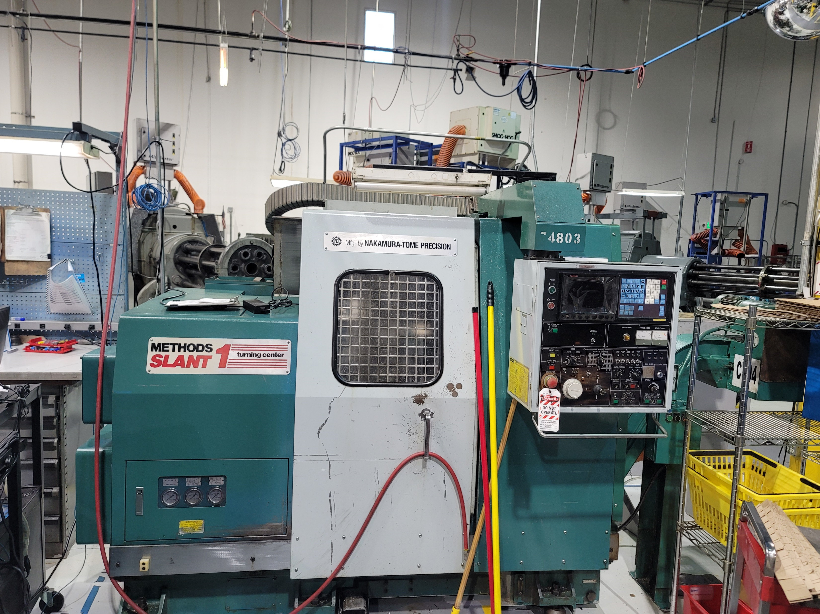
Nakamura Slant 3 Lathe -CNC04 - S-1H C 22207

