Slide 1
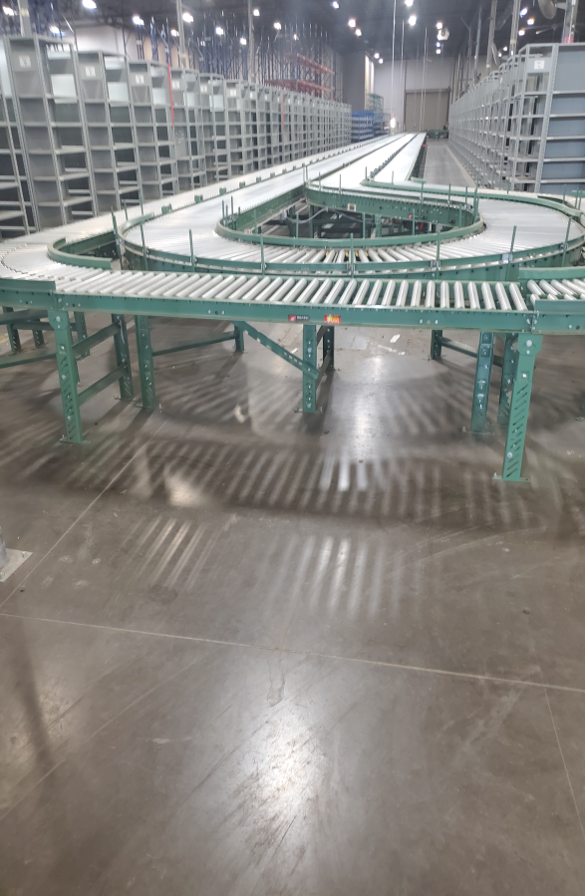
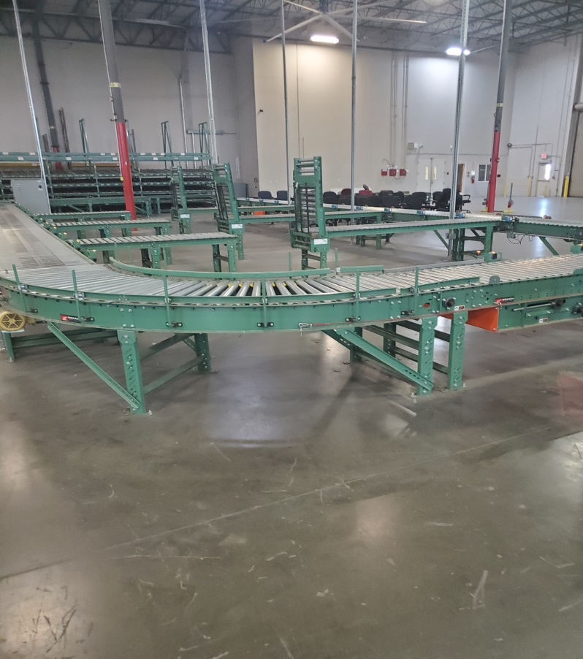
Powered Roach Conveyor System – approximately 1,100 Linear Feet

