Slide 1
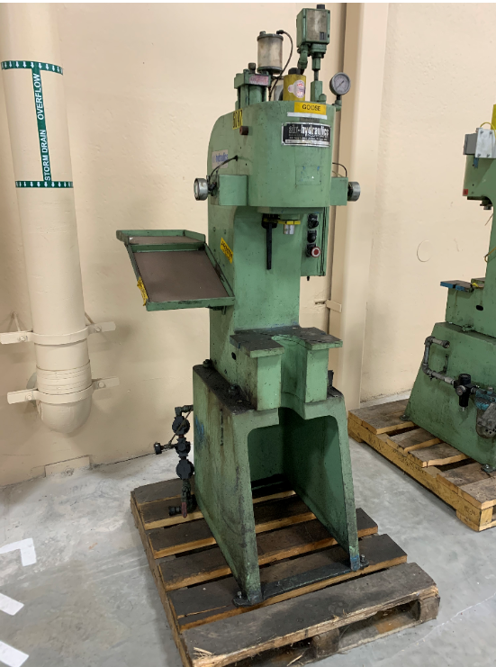
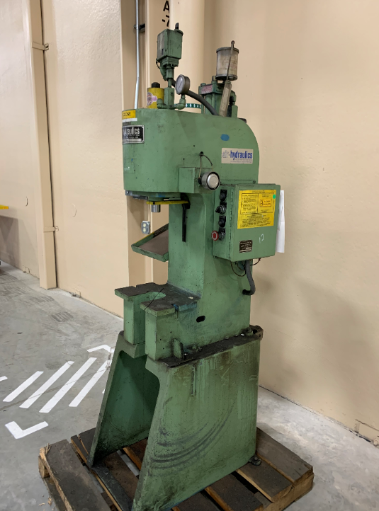
RX01-6047: Press,Hyd,AirHydraulics,C400A, SN 6210-4
Daylight: 16”

Slide 2
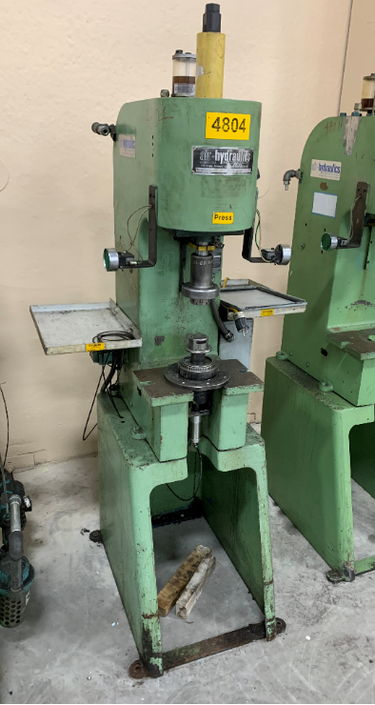
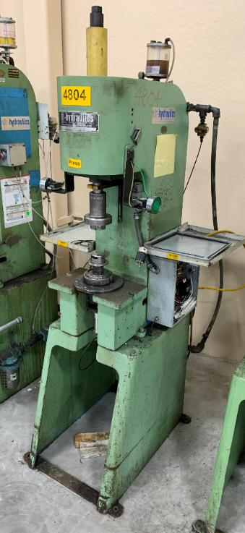
RX01-4804: Press,Hyd,AirHydraulics,C400A, SN 4583E
Daylight: 16”

Slide 3
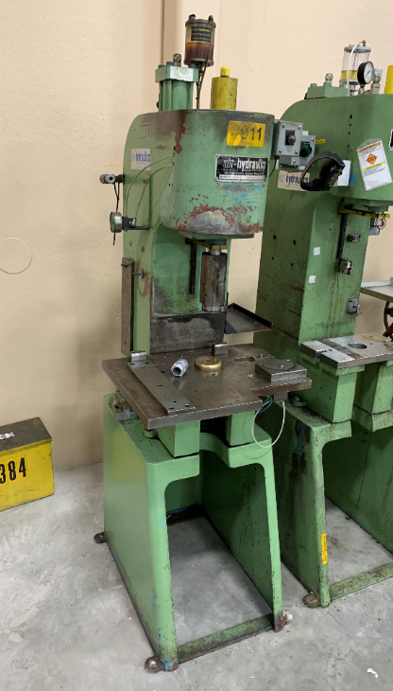
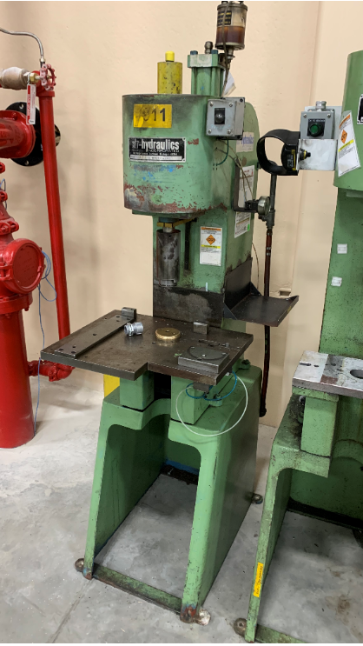
RX01-4911: Press,Hyd,AirHydraulics,C400A, SN 4583G
Daylight: 16”

Slide 4
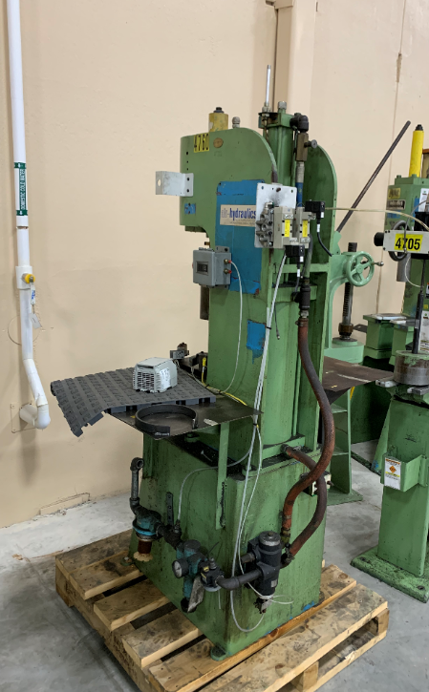
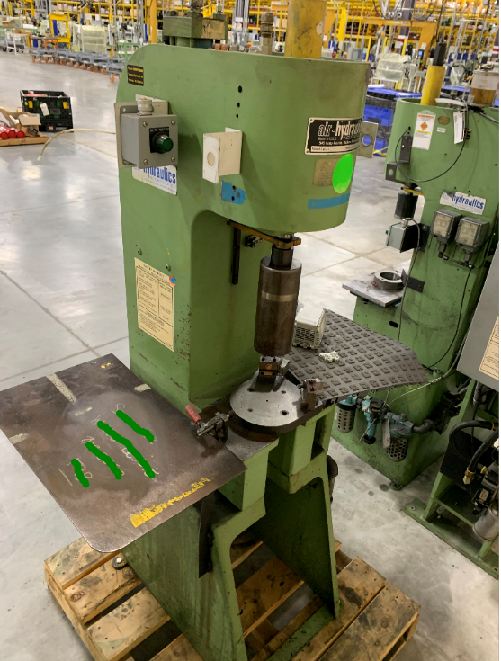
RX01-4760: Press,Hyd,AirHydraulics,C400A, SN 4526B
Daylight: 19”

Slide 5
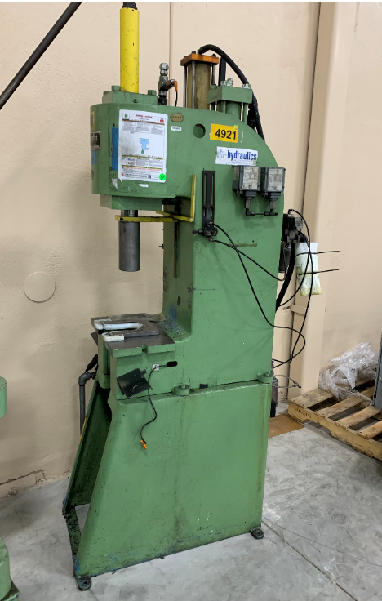
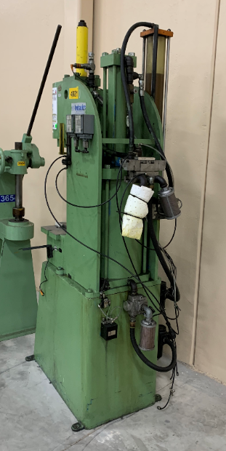
RX01-4921: Press,Hyd,AirHydraulics,C500A, SN 4789
Daylight: 19”

Slide 6
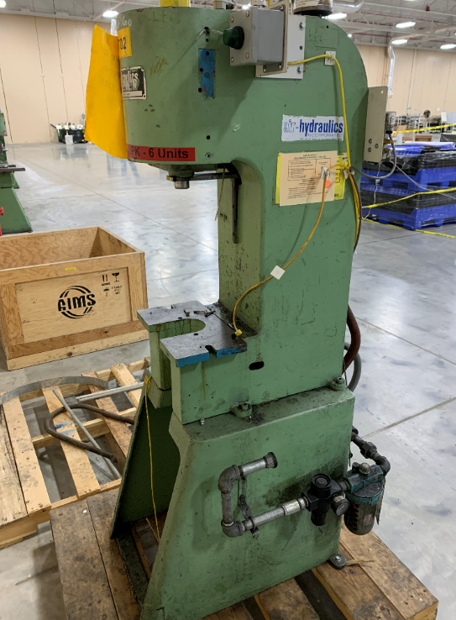
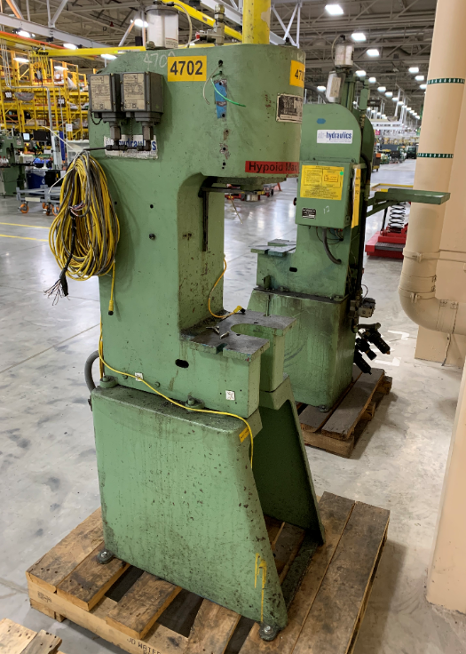
RX01-4702: 5 1/2 TON PRESS C300A SN 4545C
Daylight: 16”

Slide 7
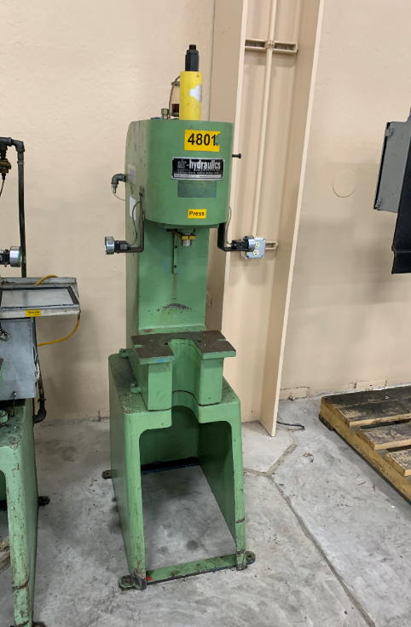
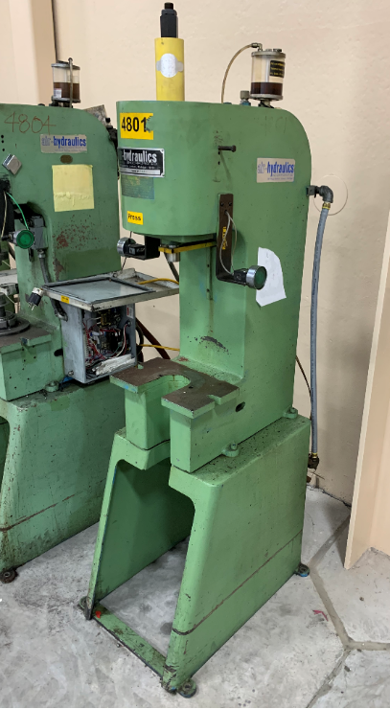
RX01-4801: Press,Hyd,AirHydraulics,C300A, SN 4583C
Daylight: 16”

