Slide 1
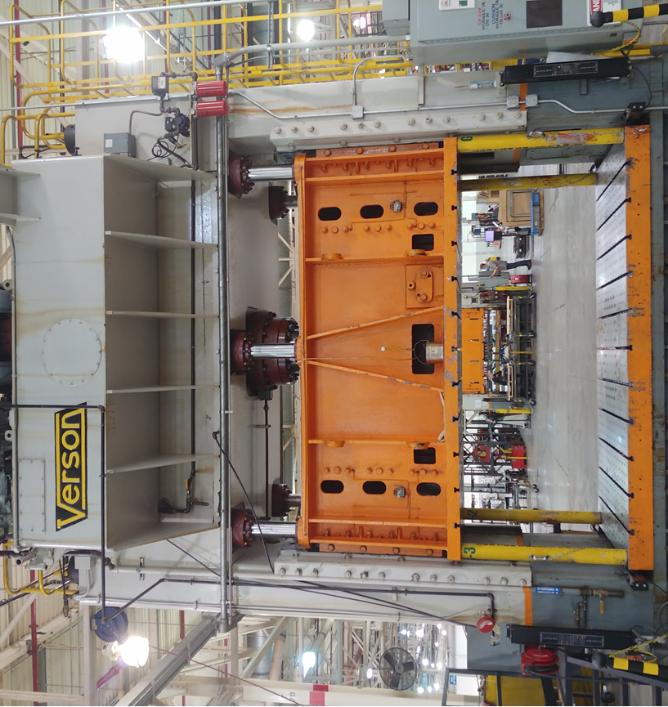
1956 Hydraulic Verson 600T press with cushion / Front view

Slide 2
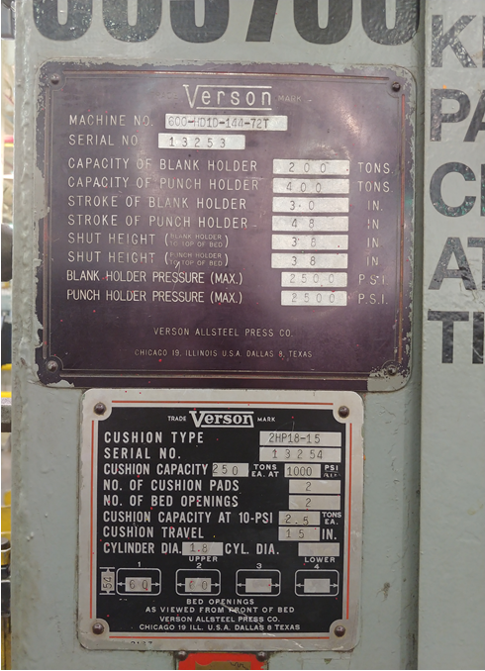
1956 Hydraulic Verson 600T press with cushion / Specifications plate

Slide 3
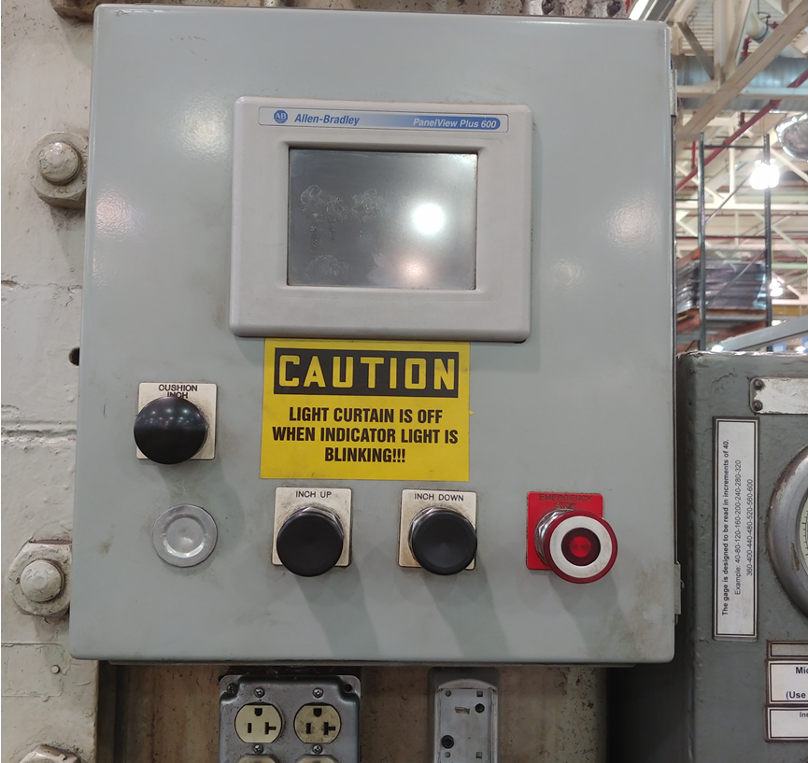
1956 Hydraulic Verson 600T press with cushion / Cushion control

Slide 4
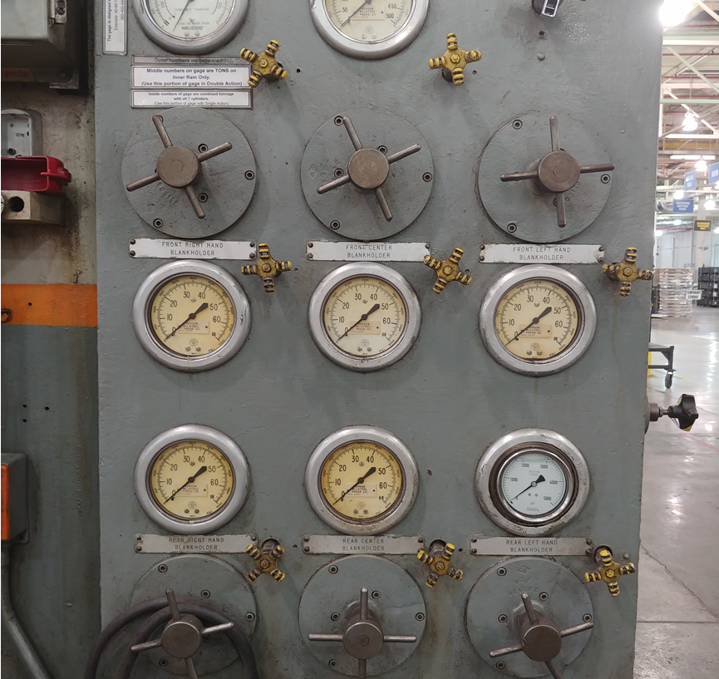
1956 Hydraulic Verson 600T press with cushion / Ram control

Slide 5
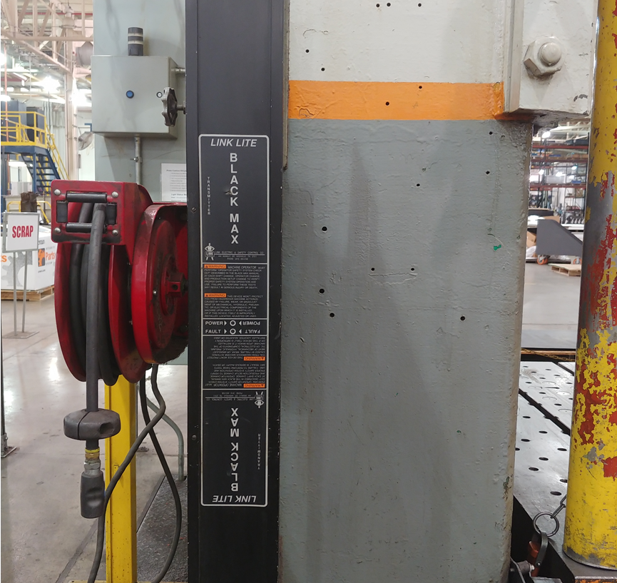
1956 Hydraulic Verson 600T press with cushion / Light curtain machine has front and rear light curtains

Slide 6
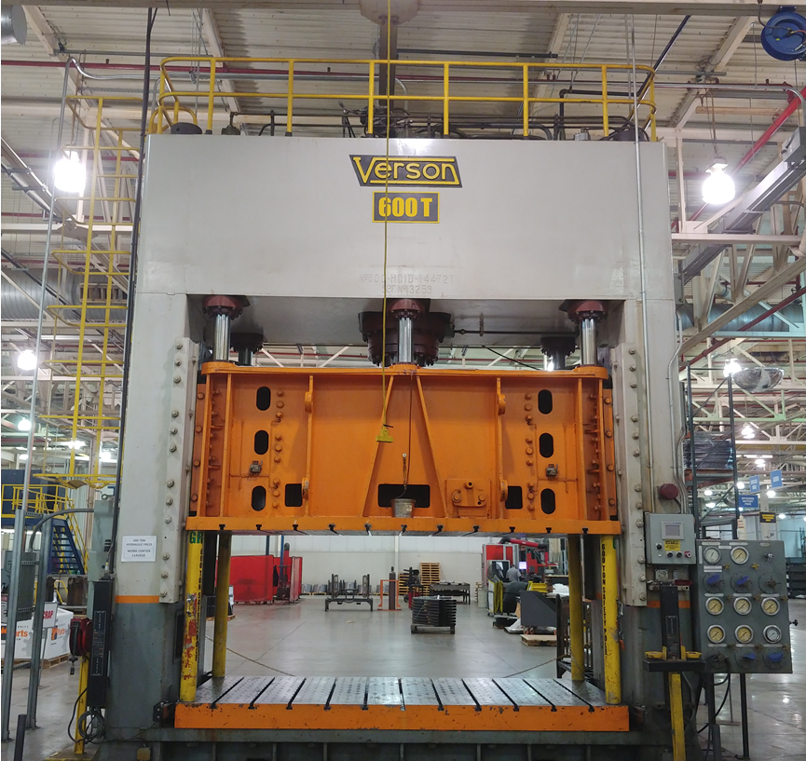
1956 Hydraulic Verson 600T press with cushion / Rear view

